Slide 1
Research Methodology- Unit 5 DATA COLLECTION AND ANALYSIS
Prime College- BIM 6th Semester

Slide 2
Research Methodology- Unit 5 Chapter 2- Questionnaire Design
Prime College- BIM 6th Semester

Slide 3


Learning Outcome 1
Introduction of Data
Questionnaires design
Components of Questionnaire
Principles of questionnaire writing;

Slide 4
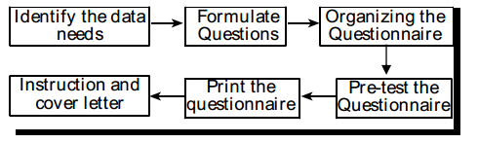
Steps in Questionnaire Designing
The questionnaire is a set of questions to collect data required for a particular research study.
Questionnaire is sent to the prospect respondents through different medium like mail, postal service, field workers, etc.
Job of preparing questionnaire is crucial as it is the base of getting high reliable and valid data from respondent.
Thus, researcher must be more sensitive while constructing a questionnaire. It is not a one shot approach.
It is outcome of cumulative works performed thoroughly by researcher or by a research team.

Slide 5
Steps in Questionnaire Designing
Step 1: Identify the data needs:
In this first step, researcher must identify or estimate what kind of data is required for the study.
Generally it is incorporated while developing overall research plan, but in the stage once recall the research problem, hypothesis and methods carefully to ensure the data needs more precisely.
Before setting the questions, researcher must revisit research framework so that each variable will be included in questions.
Researcher should also determine the respondents, their level of understanding, use of enumerators or field workers, etc. for choosing the words and required level of data.
In this stage, all the data requirements are estimated.
Step 2: Formulate the questions:
After ensuring the data required for the study,
the researcher should now prepare a list of questions.
Questions for each variable must be included because once the questionnaire is distributed, the researcher cannot correct change, or add the questions.
The following considerations must be made while developing questions:
Each variable under the study must be addressed.
The language used in the question statement must be simple and easy to understand.
Questions must not be ambiguous. The word should be selected so that all the respondents will understand in the same way. For example: To collect information regarding the job holder and what they do in their office holidays, questions may be:
Q1: What do you do on Saturday?
Q2: What do you do in your weekly holiday?

Slide 6
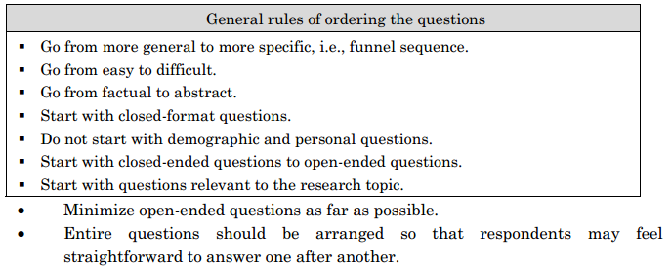
Steps in Questionnaire Designing
Step 3: Organizing the questionnaire:
After making a detailed list of questions, these questions must be organized logically to make a natural and spontaneous reply to each question possible.
While organizing the questionnaire, the following facts must be taken into consideration:
Start with an easy question.
Arrange the questions from general to specific.
Decide whether single or multiple questions require getting sufficient information to fulfill the desired objectives of the research.
A logical arrangement of the questions must be ensured while organizing a questionnaire.
For example:
Q1: How many children do you have?
Q2: Are you married or unmarried?

Slide 7
Steps in Questionnaire Designing
Step 4: Pre–test the questionnaire:
Before administering the questionnaire fully, it is better to adopt a preliminary experiment on a small sample.
Testing the significance of the questionnaire to a small group of respondents is called pre–testing of the questionnaire.
This helps to change or improve the questionnaire before implementing it fully in a large group of respondents so that cost and time can be saved.
This helps to increase the reliability and validity of research findings.
Pretesting enhances the qualities of the questionnaire because of the following advantages:
 The researcher identifies what are the drawbacks of the questionnaire and the required improvements for administering it in full–phase research.
 An idea can be formed about the extent of non–response likely to occur.
 The cooperation of the informants can be secured.
Step 5: Printing the questionnaire:
After the required corrections, the questionnaire should be printed in the appropriate format.
The questionnaire should look as attractive as possible so that it motivates respondents to fill it out and return it.
Thus, physical appearance is one of the important aspects of questionnaire instruction.
An attractive layout with comfortable line spacing and enough space for responses must be ensured while printing the questionnaire.
Some tactical aspects of printing a questionnaire to make it more effective and attractive are as follows:
 Quality and size of the paper.
 Quality of typing, layout design, and printing.
 Attractive presentation of question items with enough margin and spacing.

Slide 8
Steps in Questionnaire Designing
Step 6: Instruction and cover letter:
Instructions are the guidelines for respondents regarding how to fill out the questionnaire.
Instructions make respondents comfortable to answer so that it will be easy to record the response in spreadsheets while data analysis.
So, it is one of the essential aspects of questionnaire formulation.
Instruction can be incorporated in separate sheets orderly and within each sheet of questions wherever necessary to elucidate instructions.
A cover letter is another inevitable part of the questionnaire which addresses the respondent with a humble request to fill in and return.
The cover letter is written with a clearly described purpose of the research. It is better to justify the significance of the research work.

Slide 9
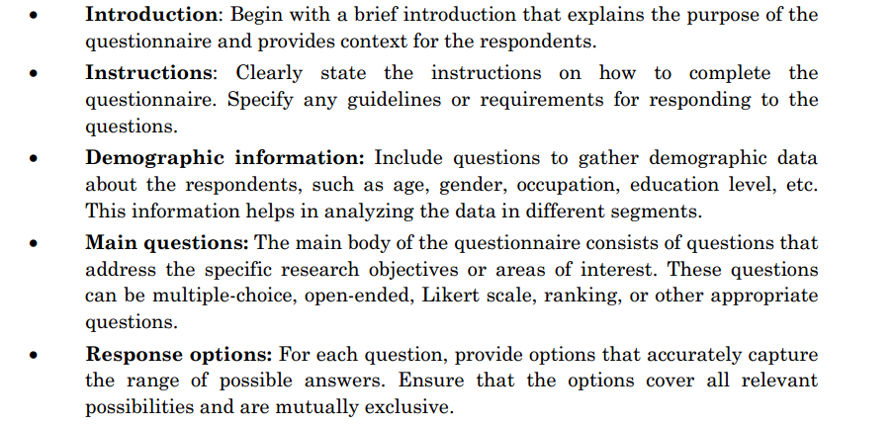
Components of Questionnaire

Slide 10
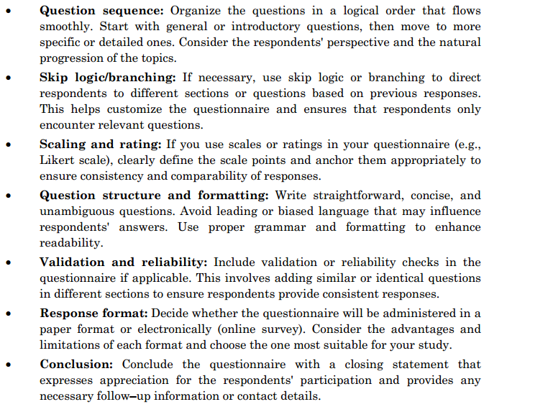
Components of Questionnaire

Slide 11
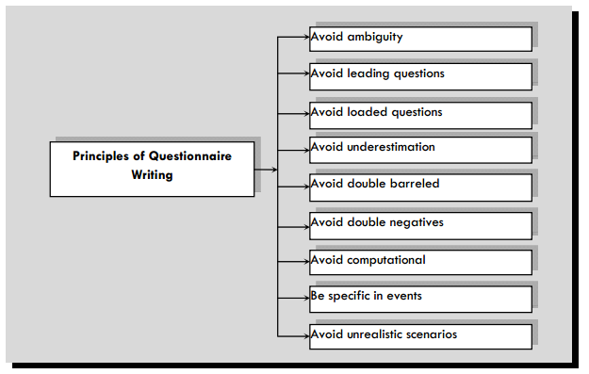
Principles of Questionnaire Writing

Slide 12
Principles of Questionnaire Writing
Avoid ambiguity: Remove confusion so that respondent can interpret the meaning of words easily. As far as possible, technical and specialized words should be avoided. Words, language and vocabulary should be selected according to the level of study population.
2. Avoid leading questions: For example, financial incentive is employees' most influential motivating factor, isn't it? In this question, the researcher is intended to get a positive answer.
Wrong: How low is the GDP of Nepal?
Right: What about the scale of GDP of Nepal?
3. Avoid loaded questions: Don’t use loaded questions; they evoke emotional responses and may skew results. For example,
Wrong: When do you enjoy drinking alcohol? (In this question, the respondent is forced psychologically to accept he/she drinks alcohol, so first confirm whether the respondent drinks.)
Right: If you drink, when do you enjoy drinking alcohol?
4. Avoid underestimation: Respondents may have egos in knowledge, approach, etc. While formulating a questionnaire, questions reflecting such egos should be avoided. For example
Wrong: Do you know the name of the Chief District Officer of your district?
Right: Do you happen to know the name of the Chief District Officer of your district?

Slide 13
Principles of Questionnaire Writing
5. Avoid double-barreled questions: A double–barreled question is a single question in which one question covers more than one topic but allows only one answer. Double–barreled questions create confusion and lead to inaccuracies in the responses because there is no indication of which topic in the double–barreled question the respondent is answering. Researchers should ensure that each question should refer to only one topic instead of multiple topics. Example:
Wrong: Do you think your job is simple and repetitive?
Right: Do you think your job is simple?
Do you think your job is repetitive?
6. Avoid double negatives: Double negatives are two negative words used in the same sentence. Using two negatives in sentences changes the sentence into a positive. They increase the chances of confusion. Examples of double negatives: Use an agreement scale of 1–5 to respond to a statement.
Wrong: Do you agree with the statement “ban policy of tobacco advertisement through electronic media should not be abolished”? (Double negatives, i.e., ban and not)
Right: Do you agree with the statement “ban policy of tobacco advertisement through electronic media should continue”? (Double negative is avoided as far
as possible.)

Slide 14
Principles of Questionnaire Writing
7. Avoid questions that need to be computed: Don’t ask respondents to perform arithmetic computations; instead ask for factual information and make the calculations during the analysis phase by researcher self.
8. Be specific in events: Write specific rather than general questions and words to communicate uniform meaning. For example:
Wrong: Did you vote in the CA election? (It is not specific.)
Right: Did you vote in the CA election held in 2009? (It is more specific.)
9. Avoid unrealistic scenarios: Researchers should not pose unrealistic or hypothetical scenarios to respondents because respondents may not relate to the reality. Example:
Wrong: Many countries across the globe are facing an economic slowdown. Do you think our country is going through a similar economic slowdown? Many respondents may disagree that the recession is affecting countries across the globe and hence could not give the correct response.
Right: Do you think our country is going through a recession now?

Slide 15
Pilot Testing and Administering of Questionnaire
Pilot testing is the act of administering a questionnaire in a small sample as a trial to observe whether there are any things to improve in a questionnaire or not.
Helpful for discovering errors.
It is the design–test–revise process of the questionnaire so that it will be possible to measure every aspect of the research problems. It is also called pre–testing.
It is essential to pilot test the instrument to ensure that the respondents understand the questions and that there are no problems with the wording or measurement.
In pilot testing, only a few respondents are included in the test to test the questions' appropriateness and comprehension.
The primary purpose of pilot testing is to identify potential problems with the methods, logistics, and questionnaire.

Slide 16
End of Chapter 2
(Click the arrow when in Slide Show mode)
Notes:
In Slide Show mode, click the arrow to enter the PowerPoint Getting Started Center.

